Slide 1
FACIAL FEATURES MONITORING FOR REAL TIME DROWSINESS DETECTION
CSE3081- DIGITAL IMAGE PROCESSING
Roll Number | Student Name
20201CSE0699 Karan K K
20201CSE0515 Siddappa
20201CSE0525 Shashank P Ravoor
20201CSE0827 Raghavendra

Slide 2
Introduction
Thousands of people lose their lives due to traffic accidents.
Human factors such as drowsiness play a key role.
Driver fatigue alone accounts for around 25% of the road accidents.
Up to 70% of such accidents result in death or serious injury
The main cause of fatigue is sleeplessness or insomnia
Need for a robust drowsiness detection algorithm

Slide 3
Literature Review
Various researchers have proposed intelligent algorithms for drowsiness detection.
In the researches have used the PERCLOS monitors for drowsiness detection.
Chung have proposed a smart watch, a PERCLOS and aheadband containing sensors to identify drowsiness.
Disadvantages:
PERCLOS Monitors are huge in size
No driver wants wear a headband and same wristwatch

Slide 4
Objectives
Real-Time Monitoring Implement a system that can continuously monitor facial features in real-time to detect signs of drowsiness, enabling instant response to potential safety risks.
Facial Feature Analysis Develop algorithms to analyze key facial features such as eyelid movement, eye blinking rate, head tilt, mouth opening, and facial expressions to identify patterns associated with drowsiness.
Data-Driven Decision Making Use machine learning techniques and datasets to create predictive models that improve the accuracy of drowsiness detection, reducing false positives and negatives.
Multi-Environment Adaptability Design a drowsiness detection system that works in various environments, including different lighting conditions, noise levels, and distractions, ensuring reliability and versatility.

Slide 5
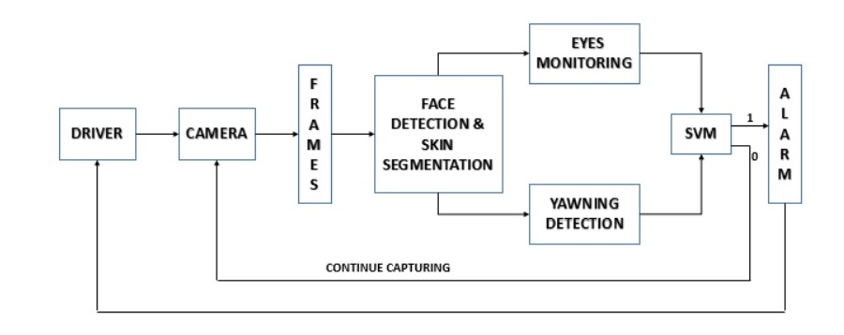
Proposed Framework
Involves 3 important stages:
1. Face Detection by Viola Jones
2. Eye State Monitoring
3. Yawning Detection
Fig. 1 The proposed Framework

Slide 6
Proposed Framework
Face Detection & Skin Segmentation
Face detection is done to minimize the false detectionsin identifying facial expressions.
Accurately locate the position of the eyes and themouth.
Skin segmentation in YCbCr domain to eliminate theeffects of luminosity.
Reject as much non face image as possible.
Even though the skin colors differ from person toperson, and race to race.
But the color remains distributed over a very tinyregion in the chrominance plane.

Slide 7
Methodology
For drowsiness detection, it is necessary to detect the state of driver’s eyes which are close or open. For this Digital Image Processing is used. MATLAB toolbox is used for image processing. There are main three steps to follow achieving the aim.
Mainly there are three steps:
(i)Face detection
(ii)Eye detection
(iii)Stage of eyes(open/closed)

Slide 8
Work Stages
IMAGE ACQUISITION: It mainly involves obtaining the image of the Automobile driver. Live image is taken as its input and then it converts those images into the series of images which are further proceed to make various operations.
MOUTH DETECTION: After detecting the face and eyes of Automobile driver with the detection function, the mouth detection is done with the help of mouth detection function. This is be done with Voila Jones Algorithm.
DROWSINESS DETECTION: Once the eyes of Automobile driver are detected, the drowsiness detection function detects whether the driver is drowsy or not, by taking into consideration whether the eyes are open or closed that is the state of the eyes and considering whether the mouth is open(yawning) or closed.

Slide 9
Work Stages
FACE DETECTION: Face detection activity takes one of the frame at a time ‘t’ from frame grabber which later tries to detect the face of Automobile Driver in every frame. And it is done with the help of Vision Cascade samples.
EYE DETECTION: After detecting the face of Automobile Driver with the face detection function, the eyes detection can be done with the help of eyes detection function. This is done using Voila Jones Algorithm.

Slide 10
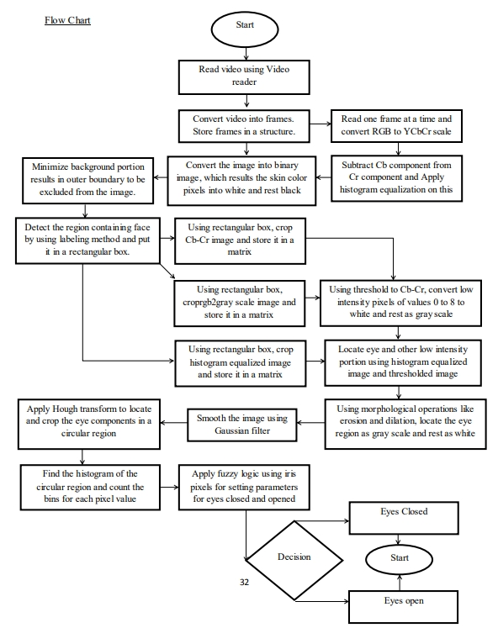
Flow Chart
Flow Chat of Proposed Drowsiness warning system

Slide 11
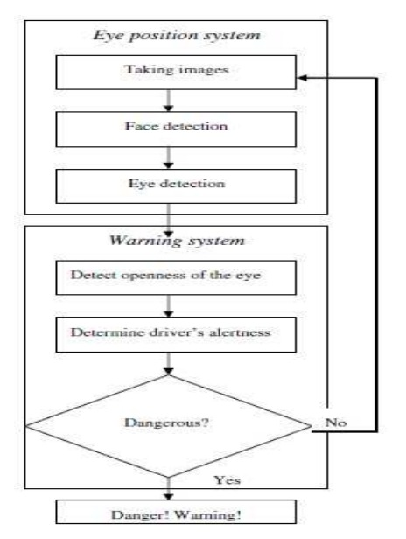
Flow Chart
Flow Chat of Proposed Drowsiness warning system

Slide 12
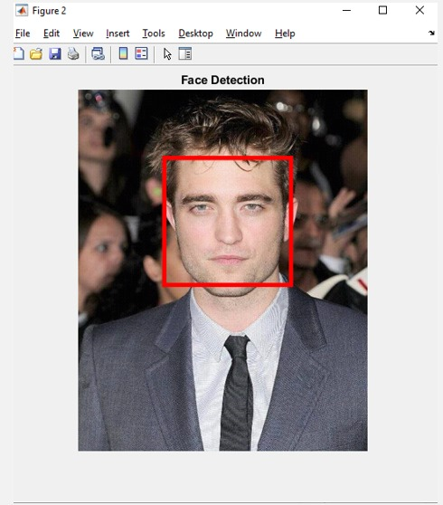
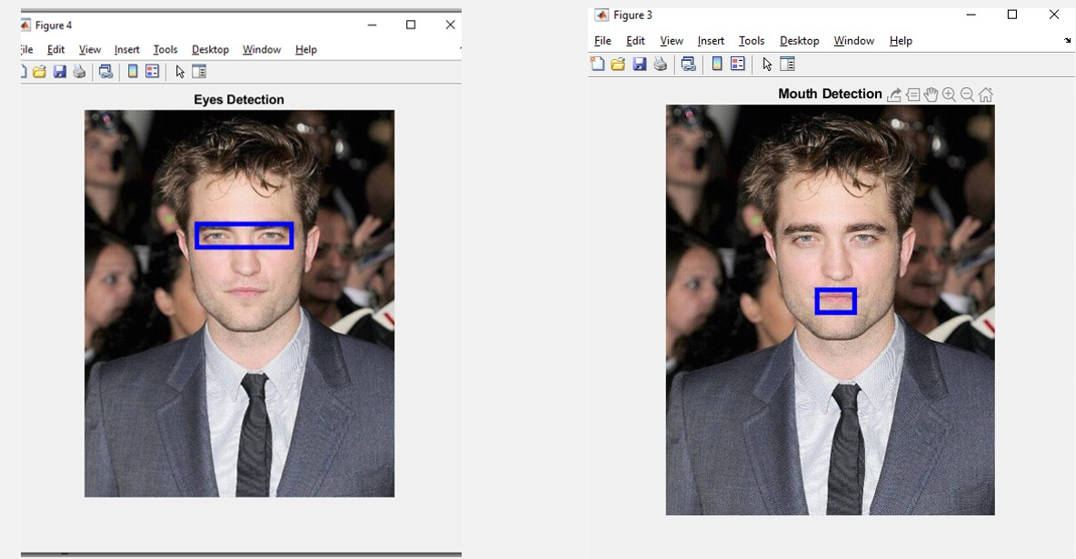
Outputs
Face Detection First Stage
Eyes an Month Detection Second Stage

Slide 13
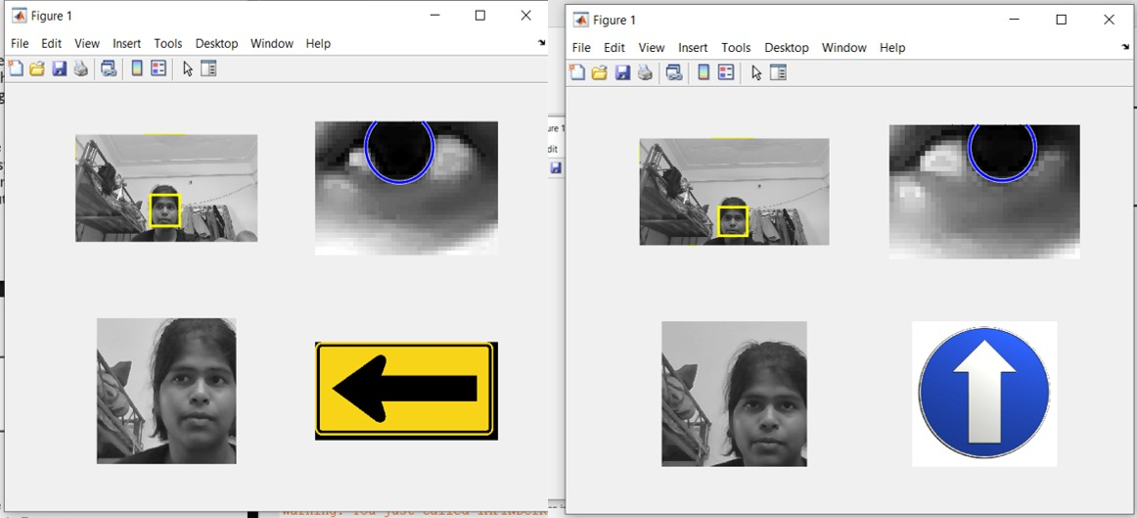
Outputs
Eye Detection and Eye Positioning Stage

Slide 14
Conclusion
This paper presents the real time implementation of drowsiness detection which is invariant to illumination and performs well under various lighting conditions.
Correlation coefficient template matchingprovides a fast way to track the eyes and mouth.
Achieves an overall accuracy of 94.58% in fourtest cases.
A high detection rate and reduced false alarms.
Can efficiently reduce the number of fatalities.

Slide 15
Conclusion
Limitations:
Unable to predict drowsiness when the head wastilted towards left or right.
The accuracy drops by 8% with spectacles.
Future Work:
Head lowering prediction is also to be included with a threshold.
Efforts will be made to make the system rotation invariant.

Slide 16
Thank You

